Slide 1
Intro to C
C
Evolved by Dennis Ritchie from two previous programming languages, BCPL and B
Used to develop UNIX
Used to write modern operating systems
Hardware independent (portable)
By late 1970's C had evolved to "Traditional C"
Standardization
Many slight variations of C existed, and were incompatible
Committee formed to create a "unambiguous, machine-independent" definition
Standard created in 1989, updated in 1999

Slide 2
The C Standard Library
C programs consist of pieces/modules called functions
A programmer can create his own functions
Advantage: the programmer knows exactly how it works
Disadvantage: time consuming
Programmers will often use the C library functions
Use these as building blocks
Avoid re-inventing the wheel
If a premade function exists, generally best to use it rather than write your own
Library functions carefully written, efficient, and portable

Slide 3
C and C++
C++
Superset of C developed by Bjarne Stroustrup at Bell Labs
"Spruces up" C, and provides object-oriented capabilities
Object-oriented design very powerful
10 to 100 fold increase in productivity
Dominant language in industry and academia

Slide 4
First Program
/* prog2_1.c
this is the very first program in the book
Program 2.1, on page 11
which is explained in detail in Chapter 2
*/
#include <stdio.h>
// starting point of every program is the main function
int main (void) {
printf("\nProgramming is fun!\n");
return 0; // tells OS that the program
// ran successfully
}
Notes:
Notice comments
multi-line comment
single-line comment above code
comments next to statements
Notice whitespace
blank lines to break up code
comment next to return statement broken into 2 single line comments and indented
Basic statement sequence
execution begins at the main() function
program’s statements execute sequentially in-order
unless loop or conditional
each statement appears on it’s own line
output statements (printf) come from stdio.h
output statements (printf) prints values to the screen (stdio)

Slide 5
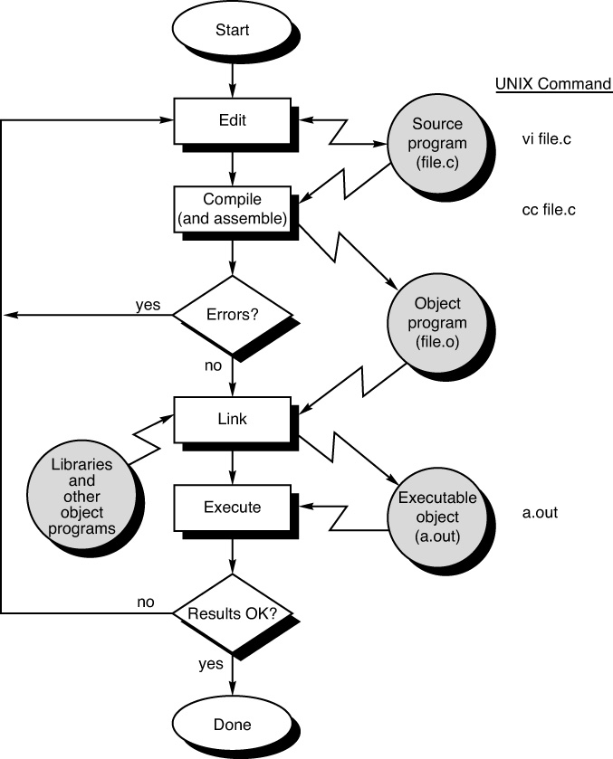

Slide 6
Incremental Development
stmt1
stmt2
stmt3
stmt4
stmt5
stmt6
stmt7
stmt8
stmt9
stmt10
stmt11
stmt12
stmt13
stmt14
stmt15
stmt16
stmt17
stmt18
stmt19
stmt20
stmt21
stmt22
stmt23
stmt24
stmt25
stmt1
stmt2
stmt3 compile & run
stmt4
stmt5 compile & run
stmt6
stmt7
stmt8
stmt9
stmt10 compile & run
stmt11
stmt12
Stmt13 compile & run
stmt14
stmt15 compile & run
stmt16
stmt17
stmt18
stmt19
stmt20
stmt21 compile & run
stmt22
stmt23
stmt24
stmt25 compile & run
vs

Slide 7
First Program – Compiler Errors
/* prog2_1.c
this is the very first program in the book
Program 2.1, on page 11
which is explained in detail in Chapter 2
*/
#include <stdio.h>
// starting point of every program is the main function
int main (void) {
printf("\nProgramming is fun!\n")
return 0; // tells OS that the program
// ran successfully
}
Notes:
The missing semi-colon is actually on line 12, not line 14.

Slide 8
Compiler Tries
stmt1
stmt2
stmt3 - - line with error
stmt4
stmt5 < - compiler message: Error at line 5
stmt6
Programmer should examine line 5 and earlier lines

Slide 9
Short Program Loaded With Errors
#include <stdio.h>
int main() {
int a = 2 b = 8, c = -3, result;
result = 6 + b a * c;
printf("result is: %d\n', result)
result = a - b + c * 5);
printf"result is: %d\n", result);
result ((a + b) + 3 * c);
printf(result is: %d\n", result);
return 0:
}
Notes:
8 lines of code inside main() function, loaded with errors

Slide 10
Fixing Compiler Errors
precedence.c: In function 'main':
precedence.c:4:12: error: expected ',' or ';' before 'b'
int a = 2 b = 8, c = -3, result;
^
precedence.c:6:2: error: 'result' undeclared (first use in this function)
result = 6 + b a * c;
^
precedence.c:6:2: note: each undeclared identifier is reported only once for each function it appears in
precedence.c:6:15: error: 'b' undeclared (first use in this function)
result = 6 + b a * c;
^
precedence.c:6:18: error: expected ';' before 'a'
result = 6 + b a * c;
^
precedence.c:7:9: warning: missing terminating " character
printf("result is: %d\n', result)
^
precedence.c:7:2: error: missing terminating " character
printf("result is: %d\n', result)
^
precedence.c:9:19: error: 'c' undeclared (first use in this function)
result = a - b + c * 5);
^
precedence.c:10:8: error: expected ';' before string constant
printf"result is: %d\n", result);
^
precedence.c:10:33: error: expected statement before ')' token
printf"result is: %d\n", result);
^
precedence.c:12:2: warning: implicit declaration of function 'result' [-Wimplicit-function-declaration]
result ((a + b) + 3 * c);
^
precedence.c:13:16: error: expected ')' before 'is'
printf(result is: %d\n", result);
^
precedence.c:13:16: error: stray '\' in program
precedence.c:13:24: warning: missing terminating " character
printf(result is: %d\n", result);
^
precedence.c:13:16: error: missing terminating " character
printf(result is: %d\n", result);
^
precedence.c:13:9: warning: passing argument 1 of 'printf' from incompatible pointer type [-Wincompatible-pointer-types]
printf(result is: %d\n", result);
^
In file included from precedence.c:1:0:
/usr/include/stdio.h:362:12: note: expected 'const char * restrict' but argument is of type 'int (*)()'
extern int printf (const char *__restrict __format, ...);
^
precedence.c:13:9: warning: format not a string literal and no format arguments [-Wformat-security]
printf(result is: %d\n", result);
^
precedence.c:16:1: error: expected ';' before '}' token
}
^
Notes:
Where to start? With the first one you understand, even if it’s in the middle? Towards the bottom and work your way up?

Slide 11
Short Program Loaded With Errors
#include <stdio.h>
int main() {
int a = 2 b = 8, c = -3, result;
result = 6 + b a * c;
printf("result is: %d\n', result)
result = a - b + c * 5);
printf"result is: %d\n", result);
result ((a + b) + 3 * c);
printf(result is: %d\n", result);
return 0:
}
Notes:
8 lines of code inside main() function, loaded with errors

Slide 12
Good Practice For Fixing Errors
do {
Focus on FIRST error message, ignoring the rest.
Find that error, either on that line specified or somewhere before it, and fix it.
Re-compile
} (repeat while more errors);
Notes:
intro to do-while loop
pseudocode

Slide 13
Compiler Warnings
Compile this way:
gcc-6 –Wall prog.c
gcc-6 will use the more recent version of gcc, closer to what Mimir uses
if you just use gcc without the -6, it will use version 5.4.0
-Wall forces all warnings to be displayed
prog.c is the name of the program
You should always FIX THE WARNINGS

Slide 14
What Is “Compilation” ?
HIGH LEVEL LANGUAGE:
// sumOfSquares.c
#include <stdio.h>
int main(void) {
int sum = 0, i = 0;
while( i <= 100 ) {
sum = sum + (i * i);
i++;
}
printf("sum is %i\n", sum);
return 0;
}
Notes:
Compilation converts the high-level language to machine language and produces an executable, if there are no errors.

Slide 15
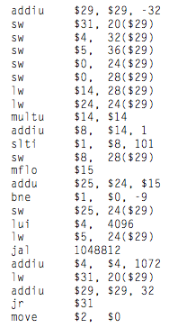
What Is “Compilation” ?
ASSEMBLY LANGUAGE (LOW-LEVEL):

Slide 16
What Is “Compilation” ?
MACHINE LANGUAGE (LOW-LEVEL):
00100111101111011111111111100000
10101111101111110000000000010100
10101111101001000000000000100000
10101111101001010000000000100100
10101111101000000000000000011000
10101111101000000000000000011100
10001111101011100000000000011100
10001111101110000000000000011000
00000001110011100000000000011001
00100101110010000000000000000001
00101001000000010000000001100101
10101111101010000000000000011100
00000000000000000111100000010010
00000011000011111100100000100001
00010100001000001111111111110111
10101111101110010000000000011000
00111100000001000001000000000000
10001111101001010000000000011000
00001100000100000000000011101100
00100100100001000000010000110000
10001111101111110000000000010100
00100111101111010000000000100000
00000011111000000000000000001000
00000000000000000001000000100001

Slide 17
Other Compiler Flags
gcc-6 prog.c –o prog will change the executable named a.out to the file named prog
gcc-6 –S prog.c will create .s file (assembly code)
gcc-6 –c prog.c will create .o file (object code)
gcc-6 –E prog.c > ppf will create file called ppf containing preprocessor results (will be a .i file)
gcc-6 –save-temps prog.c will create .i, .s, & .o files

